Slide 1


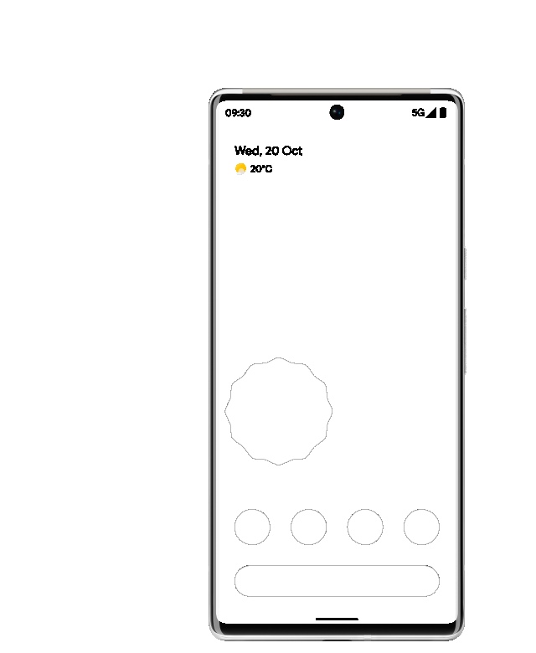


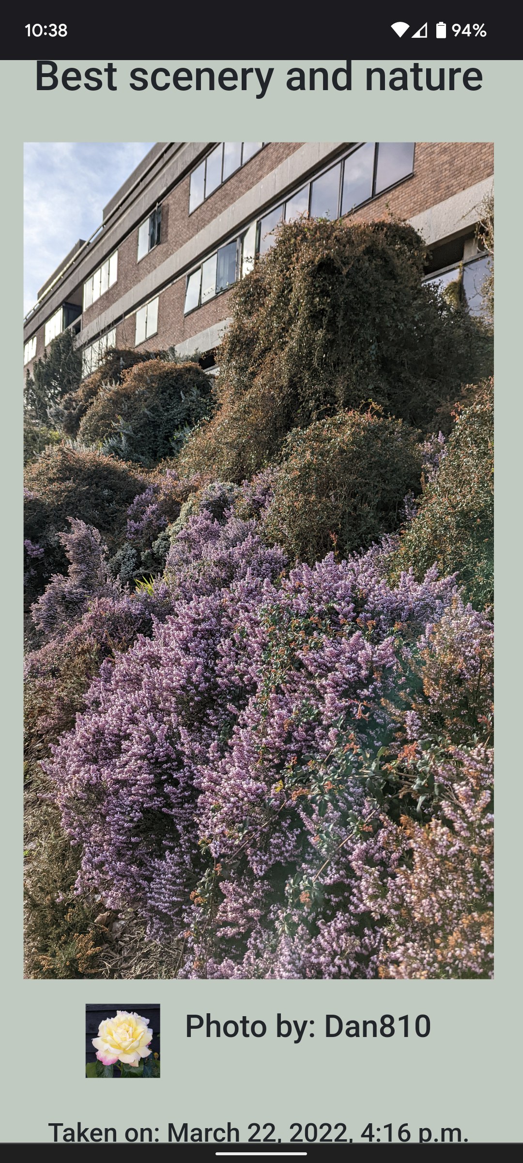
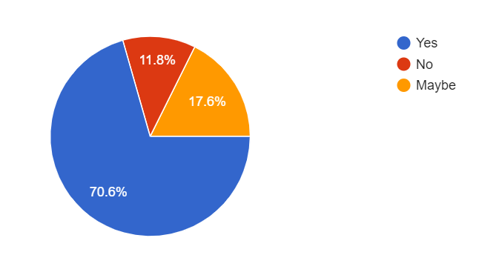


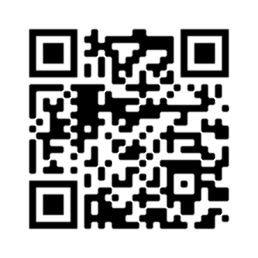
BeautySpot
The photo taking challenge
Explore Campus
Discover campus’s most beautiful spots.
Make New Friends
Meet fellow students for group photos.
Earn Rewards
Participate and climb the leaderboard to achieve badges
Show off your Creativity
Put your best work on display in the shared feed.
Connect with Nature
Seek out the diverse range of wildlife across campus.
“A breath of fresh air compared to other apps”
A second year Psychology Student
Would you be more excited to use an app if you knew it used AI?
Toby, Harry, Jack, Shalan, Jason and Artur
Scan me
POWERED BY A.I.

